Slide 1
“
Campus Food Ordering System
”
Group Members:
Huang Tianjian 117010099
Zeng Lewei 117010366
Wu Runzhong 117010289
Zhang Pinfang 117010383

Slide 2
CONTENTS
PART 03.
Design
Implementation
PART 01.
PART 04.
Introduction
Demo
PART 02.
PART 05.
Requirements Analysis
Conclusion
Further Improvement

Slide 3
Introduction
PART 01.

Slide 4
Introduction
PART ONE
Canteens – a major food source
Growing inconvenience:
students ↑, canteens and seats →
concentrated time (11:20 – 12:40, 5:00 – 6:30)
students and employees, tourists and visitors
Insufficient seats and long queues
Solution – create an “Mei Tuan”
Our project: order food online, food delivery service

Slide 5
Requirements
Analysis
PART 02.

Slide 6
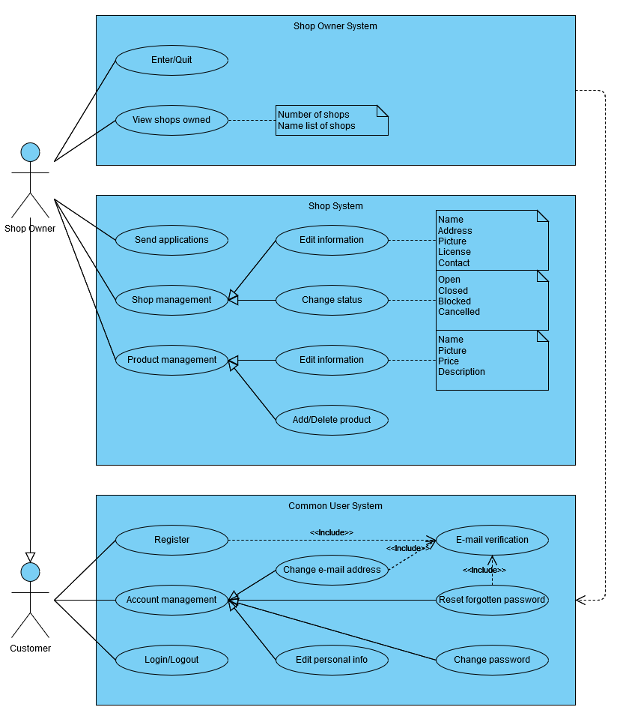
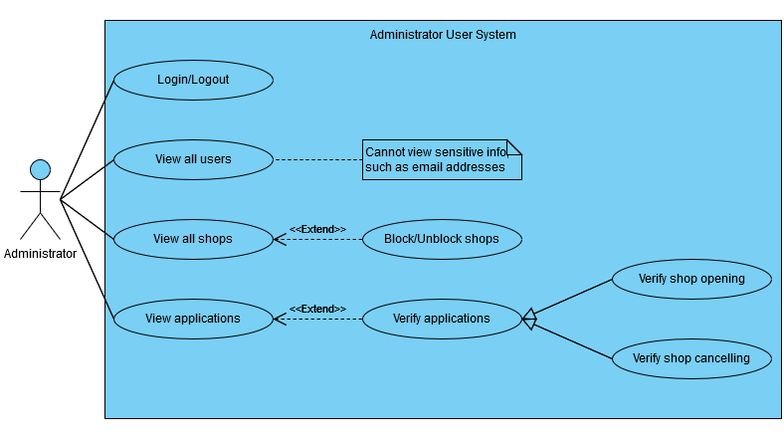
Requirements Analysis
PART TWO

Slide 7
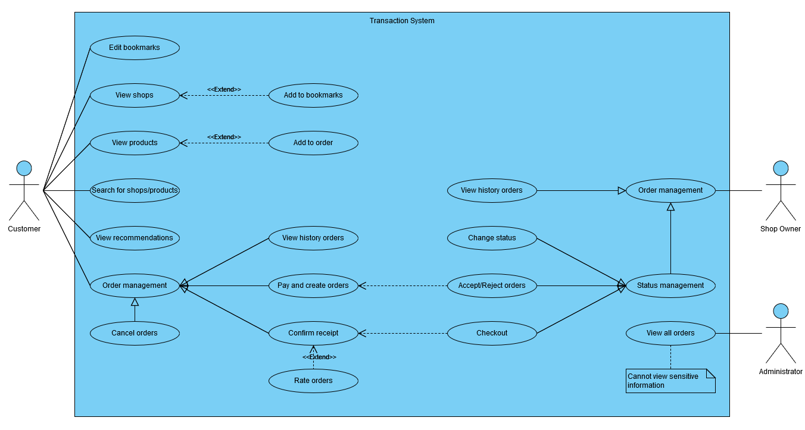
Requirements Analysis
PART TWO

Slide 8
Design
Implementation
PART 03.

Slide 9



Design and Implementation
PART THREE
Python
Flask
Vue.js

Slide 10
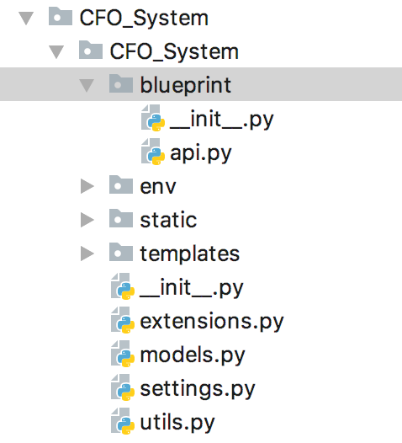
Design and Implementation
PART THREE
defines API blueprints that process database transactions and business logic.
stores environmental variables.
initializes the web app, such as loading database objects, holding context, registering blueprints, etc.
initializes and stores extensions.
defines database models in Python classes.
stores global variables and global contexts.
stores auxiliary methods which are constantly used.

Slide 11
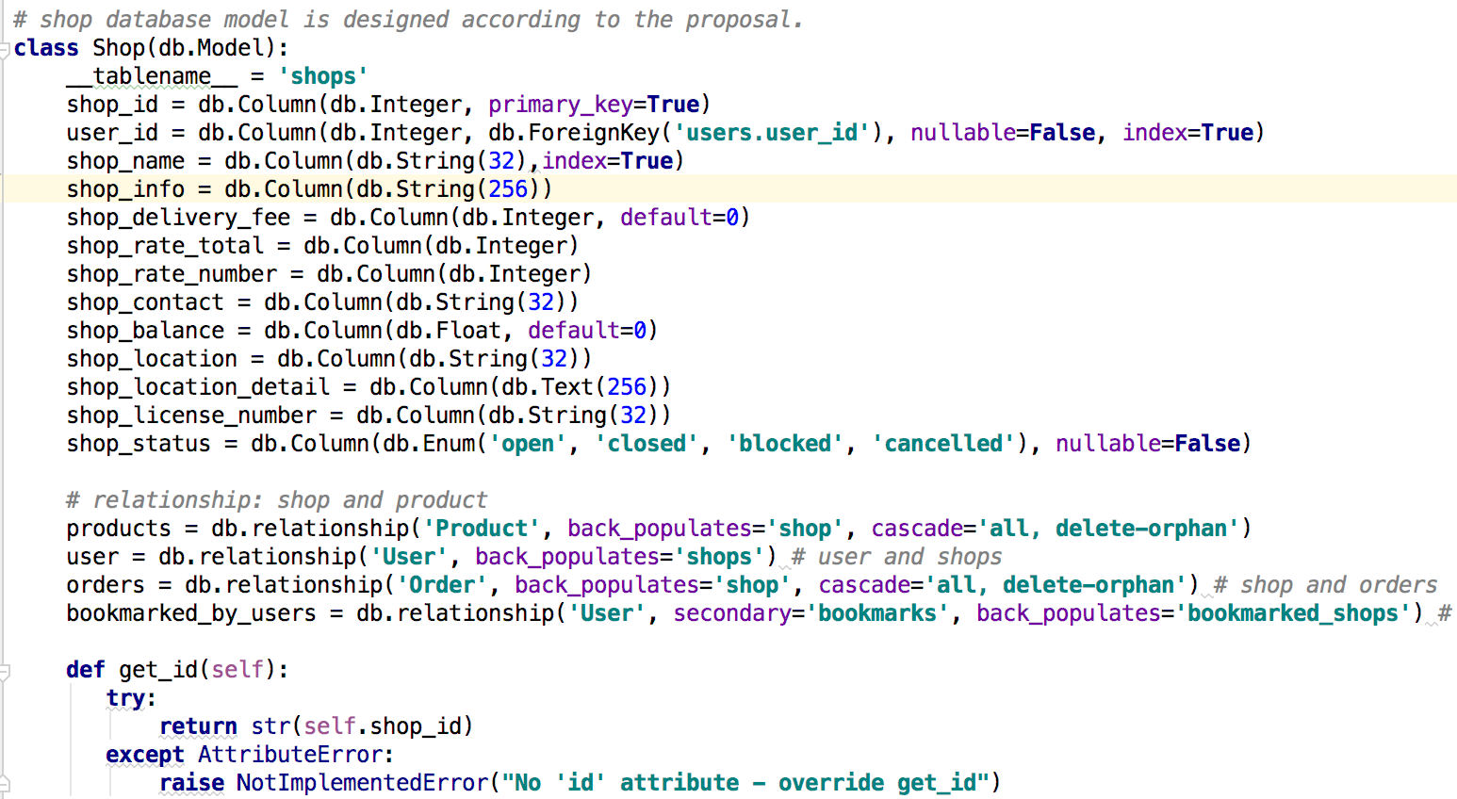
Design and Implementation
PART THREE
Example of relational models in Flask-SQLAlchemy

Slide 12
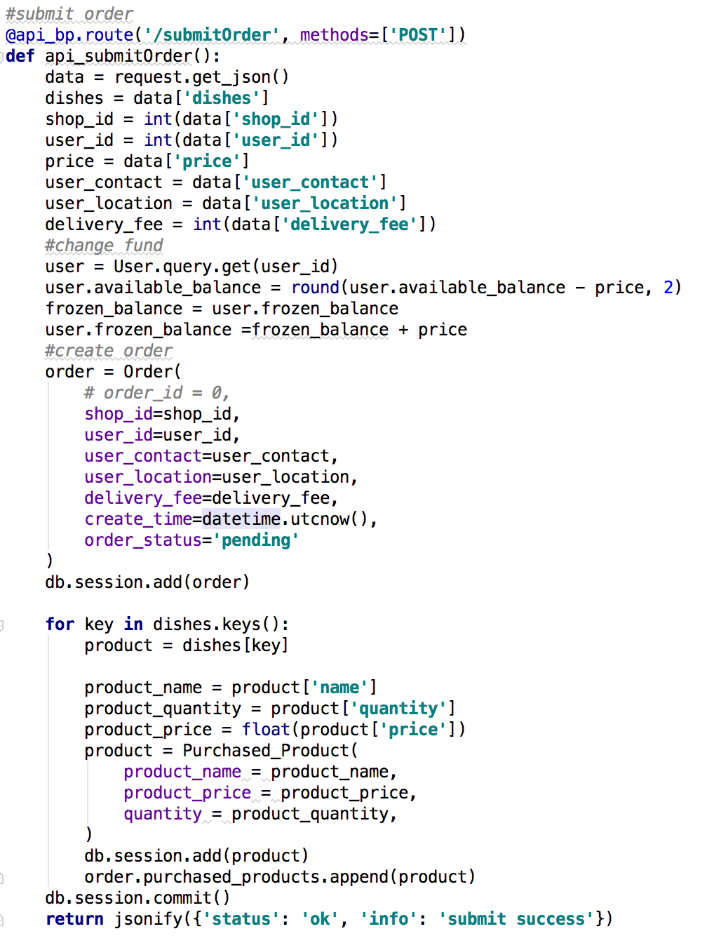
Design and Implementation
PART THREE

Slide 13
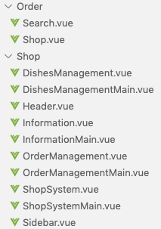
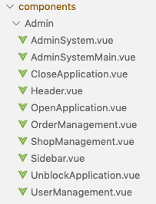
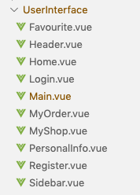
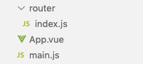
Design and Implementation
PART THREE
Admin system
Shop system
User system
Router and
Core files

Slide 14
Demo
PART 04.

Slide 15
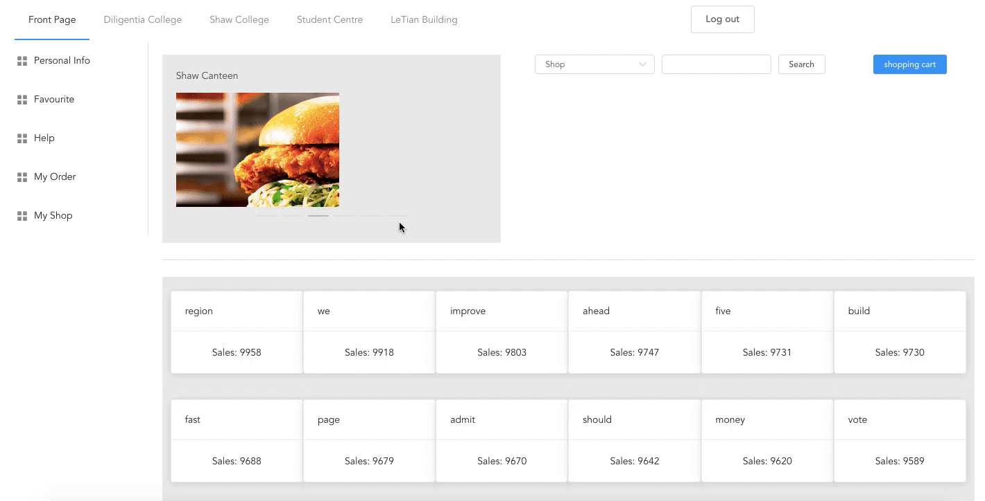
Demo
PART FOUR

Slide 16
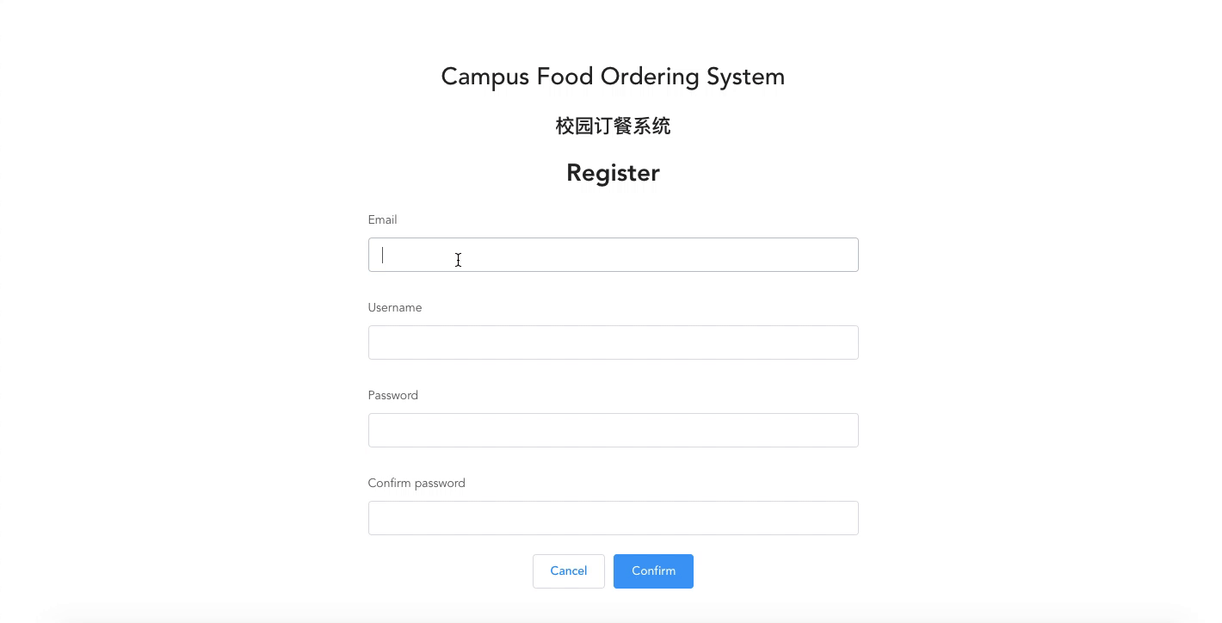
Demo
PART FOUR

Slide 17
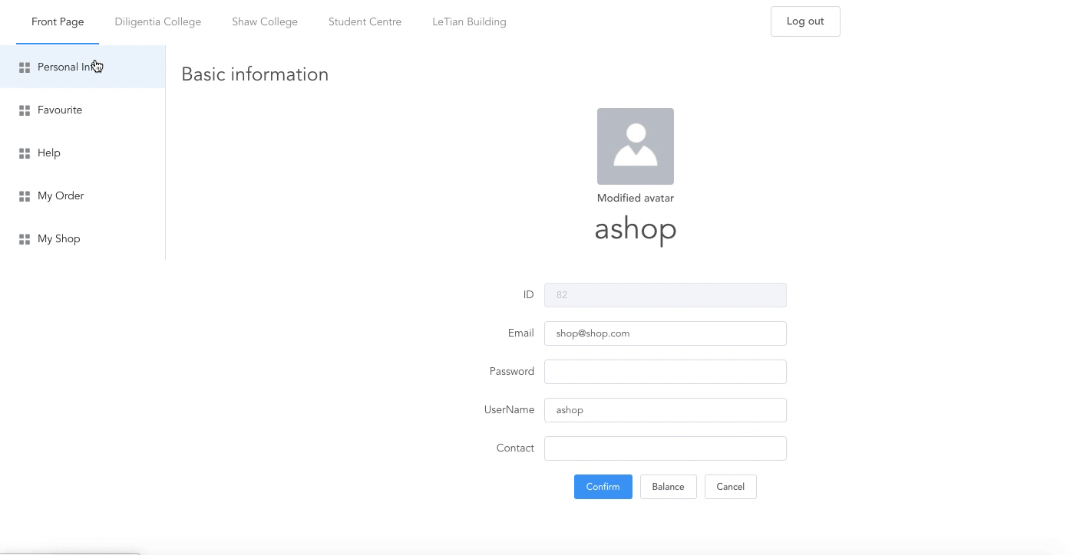
Demo
PART FOUR

Slide 18
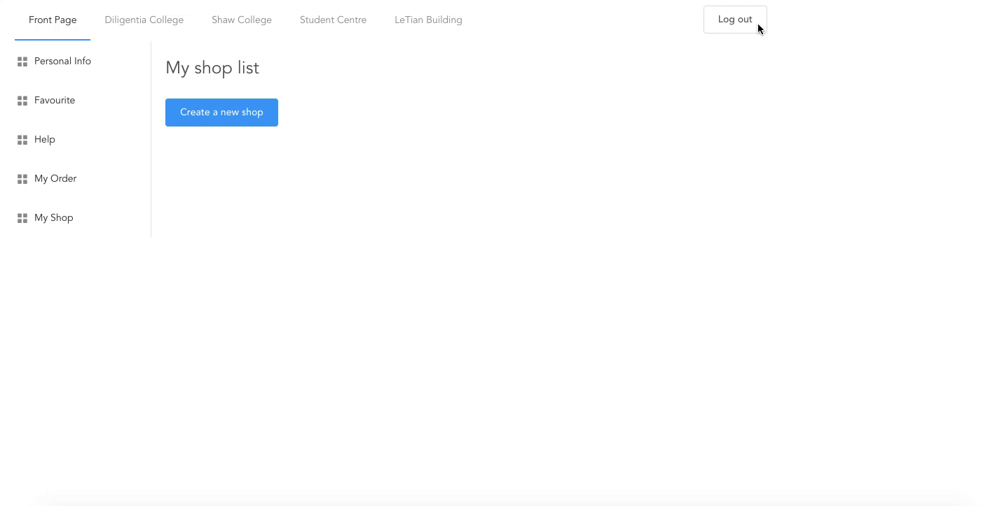
Demo
PART FOUR

Slide 19
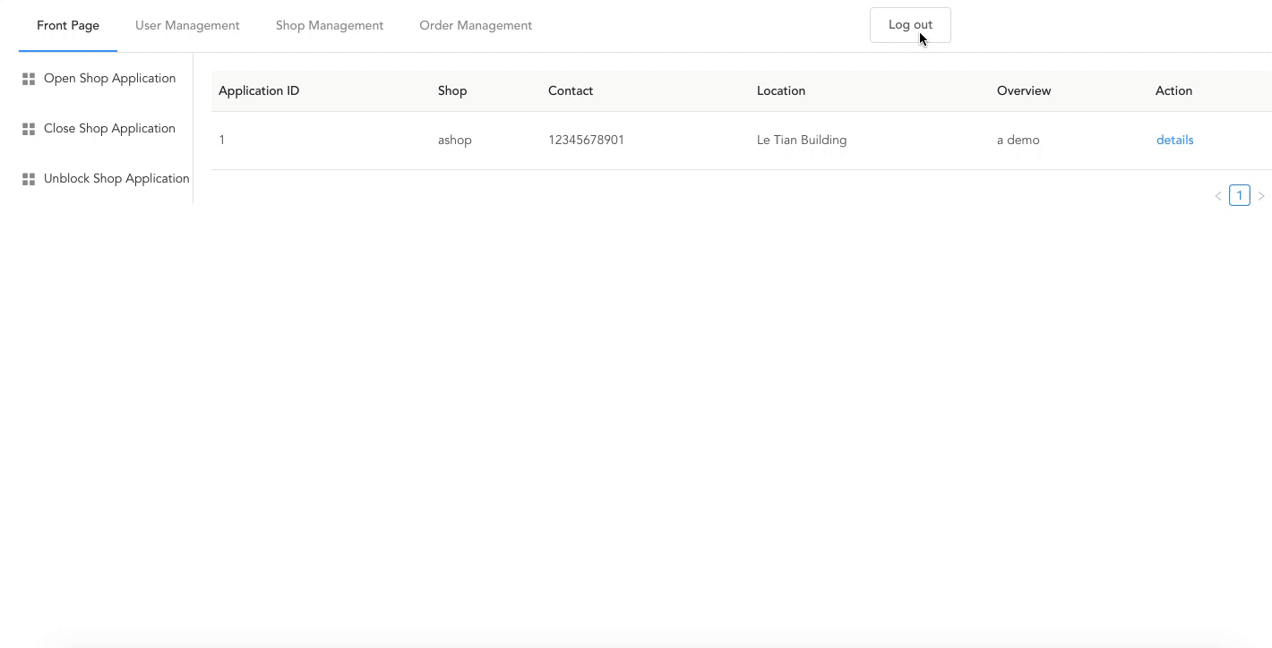
Demo
PART FOUR

Slide 20
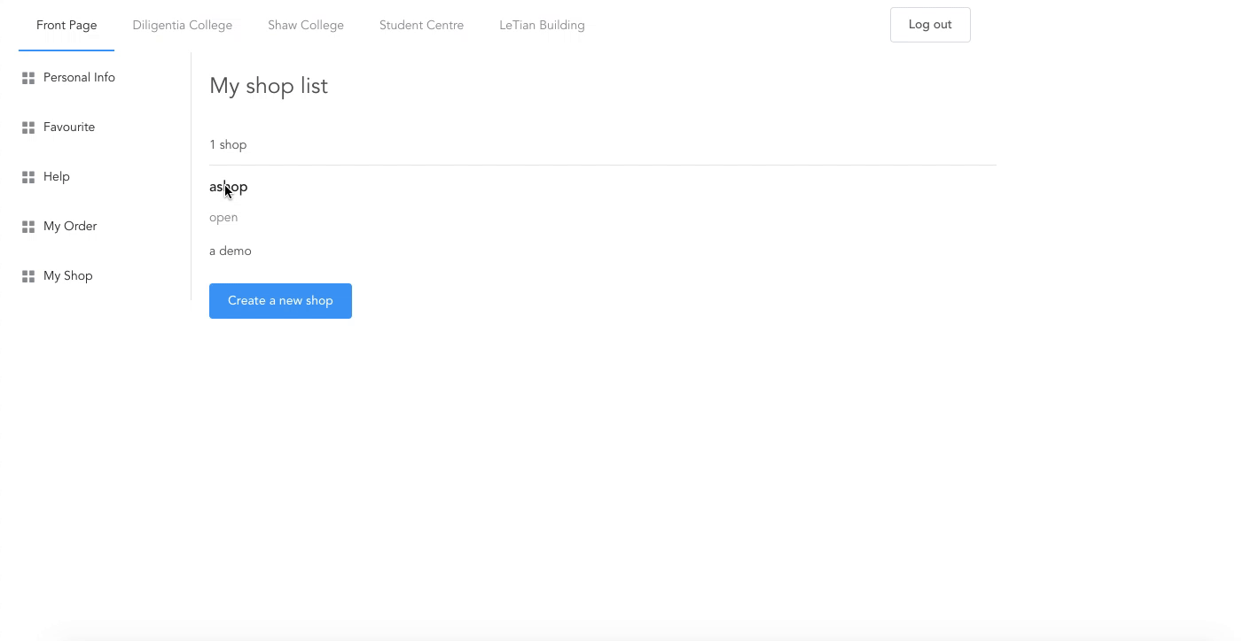
Demo
PART FOUR

Slide 21
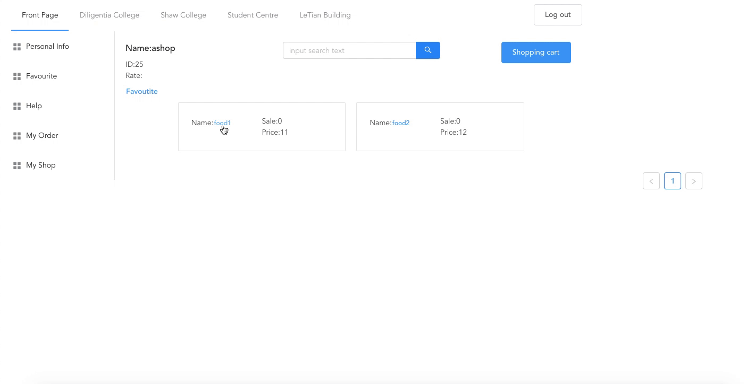
Demo
PART FOUR

Slide 22
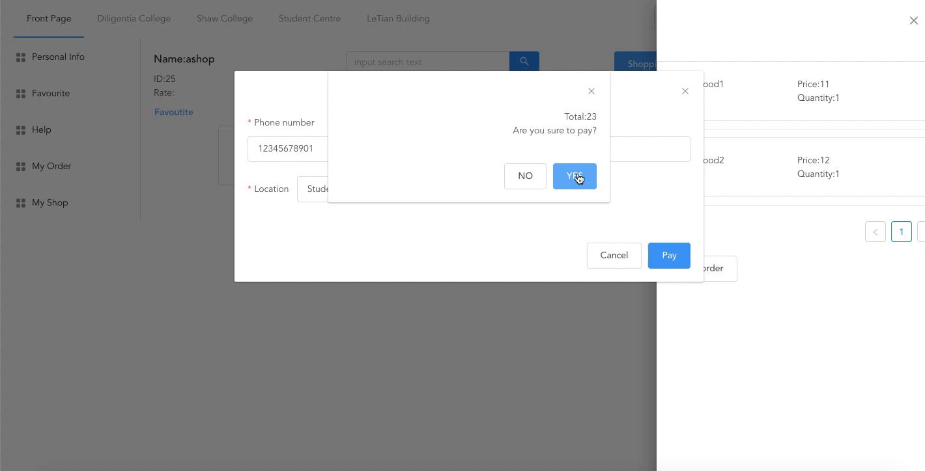
Demo
PART FOUR

Slide 23

Demo
PART FOUR

Slide 24
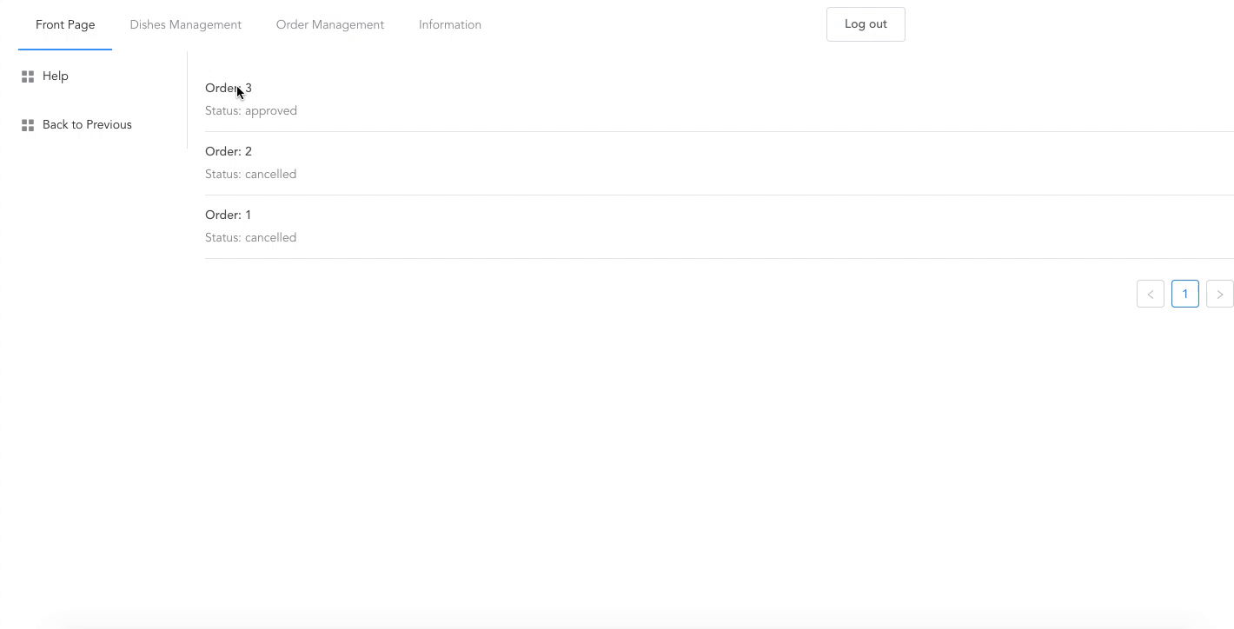
Demo
PART FOUR

Slide 25
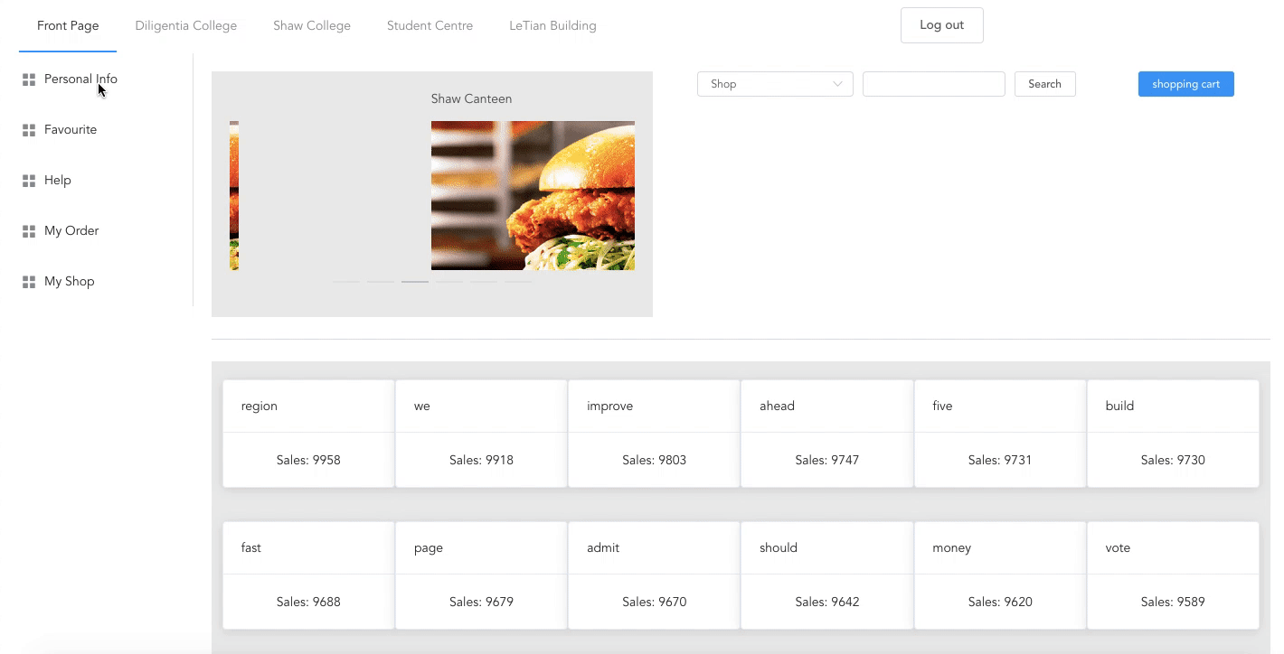
Demo
PART FOUR

Slide 26
Conclusion
Further Improvement
PART 05.

